Slide 1
Transformers as generative models for neural activity
Jonas Himmetsberger
TU Wien
e12315363@student.tuwien.ac.at

Slide 2
Agenda OUTLINE
Context & state of the art Transformers for neural spiking activity; why evaluation is hard
Two scientific questions Architecture: What did SpikeGPT improve? Evaluation: how to score generation?
Results Architecture comparison, Brain FID, metric validation, limitations

Slide 3
Scientific context & state of the art

Slide 4
CONTEXT Transformers in neuroscience Short recap of Bellec Guillaumes’ talk
The architecture behind LLMs applied to neural spike activity (see: spike_gpt.py, notebook 2)
Spikes as sequences
Why transformers
The promise
A recording is a binary raster: neurons x time bins. Naturally a sequence-modelling problem.
Parallel, scalable, capture long-range structure + no recurrence bottleneck like RNNs.
One model across sessions, animals, brain regions (a “foundation model” for neural data)

Slide 5
STATE OF THE ART Prior work
Bellec et al.
2021 · NeurIPS
Fitting summary statistics of neural data with a differentiable spiking network simulator
Fitting spiking nets by likelihood alone yields unrealistic activity; add summary-statistic dissimilarity terms to fix it.
https://proceedings.neurips.cc/paper_files/paper/2021/hash/9a32ff36c65e8ba30915a21b7bd76506-Abstract.html
Sourmpis et al.
2023 · NeurIPS
Trial matching: optimal-transport distance between generated and recorded trial distributions captures variability. Trial matching: capturing variability with data-constrained spiking neural networks
https://proceedings.neurips.cc/paper_files/paper/2023/hash/ec702dd6e83b2113a43614685a7e2ac6-Abstract-Conference.html
Sourmpis, Bellec et al.
2025 · eLife
Perturbation test: biologically informed cortical models (RNNs) predict optogenetic effects — even when they fit worse on test data.
https://elifesciences.org/reviewed-preprints/106827
Ye et al.
2025 · ICLR (NDT3)
Transformer foundation model for motor decoding, 2000h data; finds scaling saturates — more data isn't enough.
A Generalist Intracortical Motor Decoder
https://openreview.net/forum?id=ONOe6cAE9I
Notes:
"The first three are my lab's own line of work on generatively evaluating neural models — that's what I build on. The last shows why it matters: scaling alone doesn’t give a good neural model. you can't just "brute-force" your way to a good neural model by making it bigger.“ I did it on transformer not RNN, LSTM and so on
Bellec et al. (2021), NeurIPS - "Showed that spiking nets trained on likelihood alone generate unrealistic activity, and that adding a term matching real activity statistics fixes it.“
Sourmpis et al. (2023), NeurIPS - "Introduced trial matching: comparing the distributions of generated and real trials to capture trial-to-trial variability."
Sourmpis, Bellec et al. (2025), eLife - "Proposed a perturbation test: good models predict how the brain reacts to interventions, even when they score worse on standard test data."
Ye et al. (2025), ICLR (NDT3) - "A large transformer for motor decoding from 2000h of data, finding that scaling saturates — more data isn't enough.”

Slide 6
Is the model good?
Discriminative
Given Input, predict target.
Spike F1, behaviour R², stimulus accuracy
Tests whether the model can read out information from neural activity
spike_gpt.py
Generative
Generate activity → judge realism
Does generated activity look like real brain data?
“Evaluating generative models of neural activity is an open question” ~G. Bellec
Notes:
Spike F1: Model predicts for hidden neurons, whether they fire in the next timestep. F1 measures how good this prediction is.
Accuracy would not work because neurons fire seldom (5% firerate, model that says 100% of time no fire is 95% right but also useless). Combines Precision (TP/(TP+FP)) + Recall (TP/(TP+FN)) → 2*P*R/(P+R). F1=1 perfect, 0 bad.
Behaviour R^2: The Model predicts a continous „behaviour signal“ from the neural activity. (Runningspeed, gaze direction, pupilsize). R^2 measures how much of the real fluctuation in behaviour is captured. R^2=1-“How far the prediction is off“/“how much the real signal fluctuates“. (1=perfect, 0=random, <0=worse than random)
Stimulus accuracy: Does the model get what kind of stimulus was shown. (classification)
So they measure and evaluate/validate real data.
Generative on the other hand: judges realism. „does the generated activity look real“

Slide 7
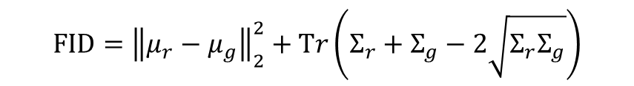
Borrowing from image generation
Fréchet Inception Distance (FID)
(Heusel et al. 2017) is the standard way to score GANs and diffusion models. It compares the distribution of real vs generated samples, not individual outputs.
Mean term:
Are the two clouds centered in the same place?
Covariance term:
Do they have the same shape and spread?
Lower = more realistic, 0 = identical distributions
$$\text{FID}={\left\|μ_{r}−μ_{g}\right\|}_{2}^{2}+\text{T}r\left(Σ_{r}+Σ_{g}−2\sqrt{Σ_{r}Σ_{g}}\right)$$
Notes:
μr​ (mu-r) — the mean vector of the real data ("r" = real). You have many real feature vectors; $μ_{r}$is their average. In your case a vector with 176 entries — the "center" of the real point cloud.
$μ_{g}$(mu-g) — the mean vector of the generated data ("g" = generated). The center of the generated point cloud.
$μ_{r}−μ_{g}$— the difference of the two centers. A vector showing how far apart and in which direction the two cloud-centers lie.
$∥⋯∥_{2}^{2}$— the squared Euclidean norm (outer superscript 2 = squared, small 2 below = L2 norm). It turns the difference vector into one non-negative number: its squared length. Intuitively: "how far is center A from center B?", as a squared distance. This is Part 1: the mean distance.
$Σ_{r}$(Sigma-r) — the covariance matrix of the real data. A 176×176 matrix describing how the features spread out and how they relate to each other — the "shape and extent" of the real point cloud.
$Σ_{g}$(Sigma-g) — the covariance matrix of the generated data. The shape/extent of the generated cloud.
$Σ_{r}Σ_{g}$— the matrix product of the two covariance matrices. An intermediate step for comparing the two shapes.
$\sqrt{Σ_{r}Σ_{g}}$— the matrix square root of that product (not element-wise! a matrix $M$with $M⋅M=Σ_{r}Σ_{g}$). This is the computationally heaviest part — in your code done via eigendecomposition. It measures the "geometric overlap" of the two shapes.
$Σ_{r}+Σ_{g}−2\sqrt{Σ_{r}Σ_{g}}$— the whole bracket. It's large when the two clouds have different shape/extent, and zero when they're identical. Conceptually the matrix analog of ${\left(a−b\right)}^{2}=a+b−2\sqrt{ab}$.
$\text{Tr}\left(⋯ \right)$— the trace of the matrix in the bracket. The trace is simply the sum of the diagonal elements of a square matrix. It collapses the whole 176×176 matrix into a single number. This is Part 2: the covariance distance.

Slide 8
From image FID to “Brain FID” Image FID feeds pictures through a NN (Inception-v3) that extracts features There is no Inception v3 for brains → Features must be hand crafted from the spikes themselves
According to Notebook2 and trial-matching framework (Sourmpis et al. 2023)
Spikes
Pool by area
Frequency features
Fréchet distance
Generated vs real raster windows
→
Average per brain region (VISp, CA1, …)
→
Oscillation power per band, 2-30 Hz
→
Compare the two feature distributions
Notes:
This is how Brain FID works in 4 steps:
Spikes: We start with two stets of spike rasters: real recordings, and sequences the model generated autoregressively. The question is whether these two look statistically the same?
Pool by area: Individual neurons are too noisy to compare directly, so we have to average them per brain region (using the atlas labels from the Allen institute). This turns 100+ neurons into a handful of population signals.
Frequency features: For each region then I extracted how much oscillation power sits in different frequency bands, from 2 to 30Hz. (2–30 Hz deckt die für kortikale Aktivität relevanten Rhythmen ab (theta ~4–8, alpha ~8–12, beta ~13–30 Hz). Unter 2 Hz ist quasi statisch, über 30 Hz brauchst du feinere Zeitauflösung als dein dt=0.02 (Nyquist-Grenze = 25 Hz) überhaupt hergibt.
Fréchet distance — Finally I compare the feature distributions of real versus generated data.

Slide 9
Scientific questions & contribution

Slide 10
Two questions
A
B
Architecture
How does SpikeGPT‘s design improve a standard GPT implementation?
Does a plain, textbook GPT — sinusoidal positions, LayerNorm, vanilla attention — reach the same performance?
Evaluation
How can one measure whether a model is a good/realistic generative model of spiking activity?
A motivates B: if both architectures score nearly the same on the usual metrics → better metrics needed
Notes:
A motivates B was my thought at first

Slide 11
SpikeGPT vs default GPT Identical training setup/hyperparams
 | Default GPT | SpikeGPT
Positional encoding | Sinusoidal, added once | Rotary (RoPE), per layer
Attention | Scaled dot-product (matmul) | FlexAttention
Normalization | LayerNorm | RMSNorm
QK normalization | None | QK-RMSNorm before RoPE
Output projection | Standard init | Zero-initialized
Notes:
My thought was: i dont want to improve the training setup or the hyperparameters those should stay the same. Only the architecture differs. My baseline is a textbook GPT and the professor‘s SpikeGPT adds multiple refinements. They of course all make sense and are SOTA choices — the question I also had then was how much do they actually matter?
Positional encoding — "How the model knows the order of timesteps: I add a fixed sinusoidal signal once at the input; SpikeGPT rotates the representations inside every attention layer (RoPE), which generalizes better to position."
Attention — "Both compute attention — mine the standard textbook way, SpikeGPT uses FlexAttention, an optimized GPU implementation."
Normalization — "How activations are kept stable during training: I use LayerNorm, SpikeGPT uses RMSNorm, a slightly simpler and faster variant."
QK normalization — "SpikeGPT additionally normalizes the queries and keys before attention for extra training stability — mine doesn't."
Output projection — "A small initialization trick: SpikeGPT starts the attention output at zero so each layer begins as a no-op, which can stabilize early training."

Slide 12
Results

Slide 13
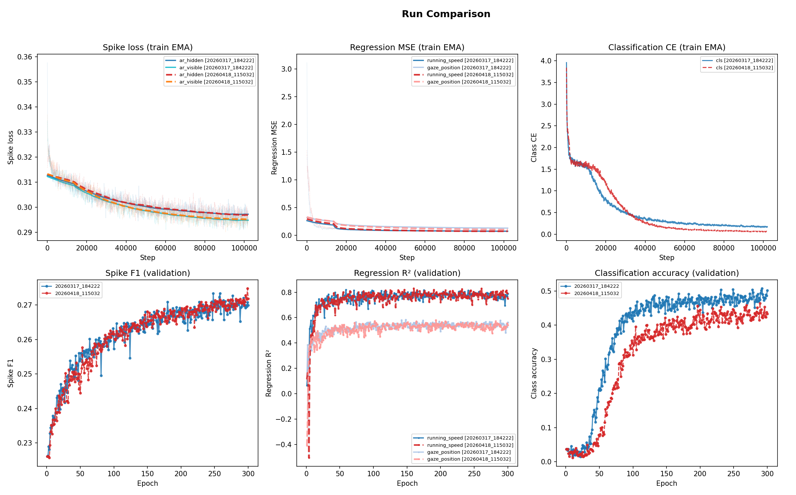
The two architectures are close RESULT A: DISCRIMINATIVE
~ equal Spike F1 (0.27)
~ equal Behaviour R² (0.8/0.55)
Classification accuracy (0.5 vs 0.4)
SpikeGPT converges faster
→ Those metrics barely separate the two models => generative metric is needed

Slide 14
Brain FID RESULT B: GENERATIVE
Global FID between real and generated activity (44 brain areas, 1000 windows each, 25% context)
Default GPT: 19.3
SpikeGPT: 24.6
Similar to result A

Slide 15
Does the metric actually work? Before trusting the comparison, I did a sanity check (destroying the structure in the real data and check how metrics react)
Metric detects population structure
Shuffling Neurons across areas => FID 7 → 49
Metric does not detect temporal structure
Time shuffling => FID 7 → 8
The frequency features, averaged over areas, are nearly invariant to temporal shuffle
Notes:
two reasons:
Reason 1: One of the features is just the average firing rate over time. If you shuffle the time order, the average doesn't change at all — so this feature can't tell the difference.
Reason 2: When you average a whole brain region together, the signal becomes slow and smooth. The features mostly capture this slow part — and shuffling time barely changes slow signals. It's the fast, moment-to-moment detail that shuffling destroys, and that's exactly what these features ignore.
"The features mostly capture how much and how slow each region fires — not the fine temporal order — so shuffling time barely moves them.“
Potential fix: Instead of only looking at rhythm, it splits the sequence into time blocks and keeps each block as its own feature — so shuffling the time order scrambles the blocks and the score finally reacts.

Slide 16
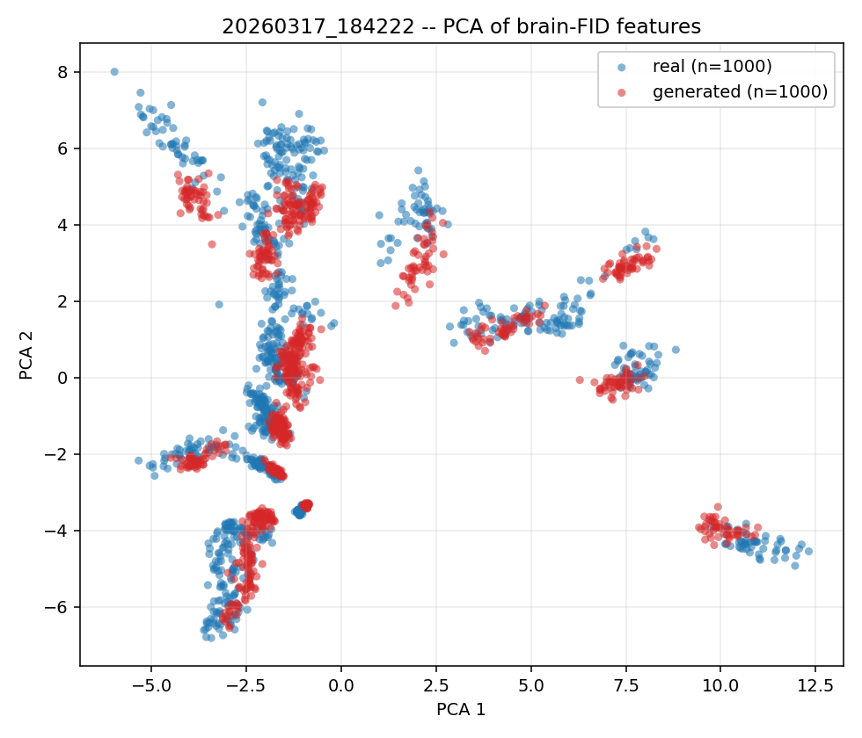
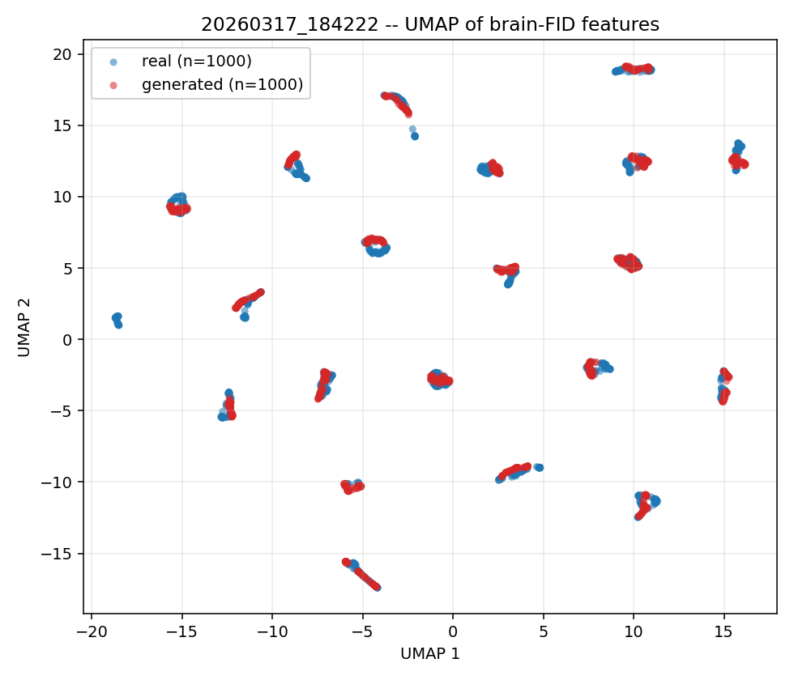
Distributions overlapped VISUALIZATION
Real (blue) vs generated (red) feature clouds, projected to 2D
overlap = realistic
separation or collapse = fail
Notes:
PCA: Finds the directions of the biggest variation and flattens everything into 2D linearly. Strength: does not distort distances → if real/generated overlap the overlap is real. Weakness: if the data has curved or complex structure, PCA can squash it into a blob and hide it.
UMAP: nonlinear projection. It tries to preserve which points are neighbors → good at revealing clusters or sub-structures. — for example if real activity falls into several distinct states (different behaviors), UMAP tends to show them as separate groups. Its weakness: it can invent structure that isn't really there, and distances between clusters aren't meaningful.
Why both: they cross-check each other — PCA for spread, UMAP for structure.

Slide 17
Big variety between sessions PER SESSION COMPARISON
Easiest sessions for both models: Session 5&20
Hardest Session: S16
Why values so much higher than global FID? (~20)
Why huge discrepancy?
Notes:
I don‘t really see this as the metrics fault. There is just to little data per session (~50 Samples vs 1000 Samples globally).

Slide 18
What this thesis contributes SUMMARY
A controlled architecture comparison
SpikeGPT speeds up classification and training
A generative metric for SpikeGPT
Brain FID adapts image FID to spikes via area-pooled frequency features
Validation of the metric
Shuffling of tests shows that the metric captures population structure but not temporal structure

Slide 19
Future Work
Fix temporal sensitivity/Make Brain FID react to temporal shuffling
Higher frequency bands or time-resolved features?
Pretrained generative transformer
Evaluate a pretrained transformer generatively with FID, starting from the Allen data
Trial-matched R²
Add optimal-transport metric to eval metric
Notes:
Potential fix: Instead of only looking at rhythm, it splits the sequence into time blocks and keeps each block as its own feature — so shuffling the time order scrambles the blocks and the score finally reacts.
I already found that Brain FID is weak on temporal structure (the time-shuffle problem).
Trial-matched R²: it matches each generated trial to its closest real trial via optimal transport and asks how well they line up. Two metrics are much more convincing than one.

Slide 20
Thank you
References
G. Bellec, S. Wang, A. Modirshanechi, J. Brea, and W. Gerstner, "Fitting summary statistics of neural data with a differentiable spiking network simulator," Advances in Neural Information Processing Systems (NeurIPS), vol. 34, pp. 18552–18563, 2021.
C. Sourmpis, C. Petersen, W. Gerstner, and G. Bellec, "Trial matching: capturing variability with data-constrained spiking neural networks," Advances in Neural Information Processing Systems (NeurIPS), vol. 36, 2023.
C. Sourmpis, C. C. H. Petersen, W. Gerstner, and G. Bellec, "Biologically informed cortical models predict optogenetic perturbations," eLife, 2025, reviewed preprint.
J. Ye, F. Rizzoglio, X. Ma, A. Smoulder, H. Mao, G. H. Blumenthal, et al., "A generalist intracortical motor decoder (NDT3)," International Conference on Learning Representations (ICLR), 2025.
Allen Institute for Brain Science, "Visual Coding – Neuropixels dataset," 2019. [Online]. Available: https://portal.brain-map.org/circuits-behavior/visual-coding-neuropixels

Slide 21
Wieso 2-30Hz (2–30 Hz, grouped into 3 bands) bzw was ist der dc component?
Was ist das problem warum der temporal shuffle nicht genau funktioniert hat?
Wieso ist der globale FID score so viel niedriger wie der per session?
Was sagen die quellen aus?
Wieso hat das notebook hier 24*4: feature_oscillation_frequency(X, f_min=2, f_max=30, num_f=24 * 4, n_group=3)
How does the FID differ from the FID in the Notebook2?
Notebook2 is a standalone analysis code for RNN. My code is easily fuseable with the trainings/eval loop of the GPT-codebase. (Adapter, SOS-Tokens, Block-Masks, Session-Handling all has to fit with the transformer architecture)

Slide 22
Was ist nochmal Hebel 3

